Slide 1
SENTIMENTAL ANALYSIS
ON STOCK MARKET
Guide Betty James
Assistant Professor
Aswin K CHN17CS032
Harikrishnan S Kartha CHN17CS055
Pranay Prince CHN17CS090
Group 14

Slide 2
ABSTRACT
Stock market prediction is the act of trying to determine the value of a company
or other financial instrument traded on financial exchange.
The successful prediction of stock's future movement will maximize investor's gain.
This system will predict the stock movement based on the sentimental value.
Being able to understand how the stock value of a company reacts on current scenarios

Slide 3
INTRODUCTION
A stock market is the aggregation of buyers and sellers of stocks, which represent ownership claims on business
The stock market is often considered the primary indicator of a country’s economic strength and development

Slide 4
Predicting stock prices based on either historical data or textual information alone has proved to be insufficient.
History has shown that the price of stocks and other assets is an important part of dynamics of economic activity, and can influence or be an indicator of social mood
Keeping up with the news on finance and particular stocks can be extremely beneficial to your strategy in stock market

Slide 5
“The stock market is designed to transfer the money from the active to the patient.”
—Warren Buffett

Slide 6
OBJECTIVE
To design an model that determines if the prices of major stocks in BSE will increase or decrease based off news sentiment
Study how the current scenarios around country affecting the companies

Slide 7
MOTIVATION
The project puts in a small effort to assist the inexperienced investors and prevent from suffering heavy capital loss
We can insight about market behaviour over time , spotting trends that would otherwise not have been noticed
A public service incorporating historical data to make stronger model that will benefit everyone

Slide 8
LITERATURE SURVEY
CITE NAME | AUTHOR | METHOD IN PAPER
Twitter as a corpus for sentiment analysis and opinion | B.Pang, L.Lee and S Vaithyanathan | Grouped the words according to positive,neutral, and negative for training
Stock market prediction using sentiment analysis | Kalyani josi,Prof Bharathi H.N | Polarity detection algorithm using vader sentiment

Slide 9
STOCK PRICES, LOCKDOWNS, AND ECONOMIC ACTIVITY IN THE TIME OF CORONAVIRUS (2021) | Steven J. Davis Dingqian Liu Xuguang Simon Sheng | How the current scenarios around the world affecting the market
Sentiment Analysis for Stock Price Prediction (2020) | Rubi Gupta, Min Chen | Uses a correlation analyzer Between stock prices and sentiment movement

Slide 10
EXISTING SYSTEM
Traditional approach:
Statistical techniques such as Bollinger Bands
In modern approaches uses a observes the relationship between sentiment score and stock prices
Collection of news
Data pre processing

Slide 11
Preparation of dictionaries
Contains words with polarity(Positive or Negative)
Check each word against weather it matches with one of the word from dictionaries
Count number of words belongs to each dictionaries
Calculate the score of document = count(pos.matches)-count(neg.matches)

Slide 12
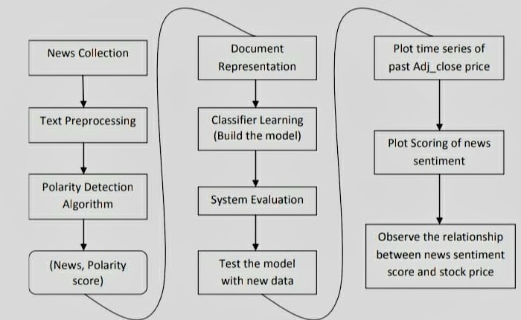
ARCHITECTURE OF EXISTING SYSTEM

Slide 13
DISADVANTAGES OF EXISTING SYSTEM
Market prices is not predictable by time series
Making dictionaries which contains words is challenging
Less accuracy

Slide 14
PROPOSED SYSTEM
The aim of this project is to build a model which
Predicts how the major BSE company stock prices of will react on current stock news

Slide 15
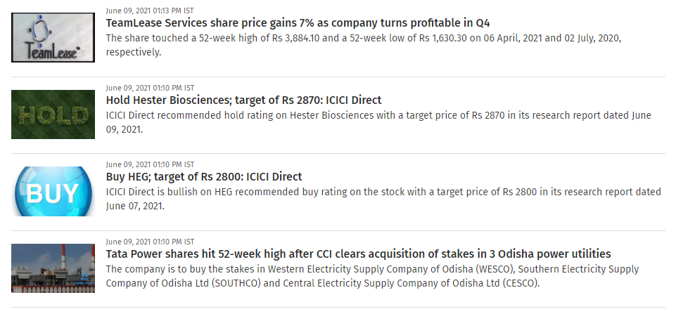
DATASET
Data set consist of two columns news & sentiment value of stock
Historical data of stocks from Yahoo Finance
Stock news are collected from Moneycontrol.com

Slide 16
MODEL ARCHITECTURE
EMBEDDING
GRU
GRU
DENSE

Slide 17
80:20 train-test data split
Train Data into 32 splits
8 epochs

Slide 18
DATA FLOW DIAGRAM
NEWS
STOCK VALUES
TOKENIZING
SENTIMENT VALUE
DATASET
TRAINING
NEWS INPUT
MODEL
SENTIMENT

Slide 19
TOOLS USED
Tensorflow
Keras
Google Collab

Slide 20
ADVANTAGES
Provides higher accuracy
No need of dictionary editing or polarity checking

Slide 21
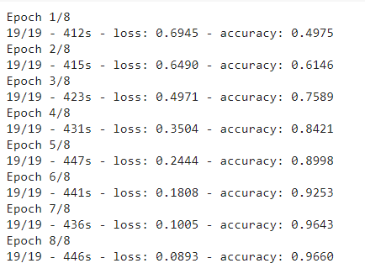
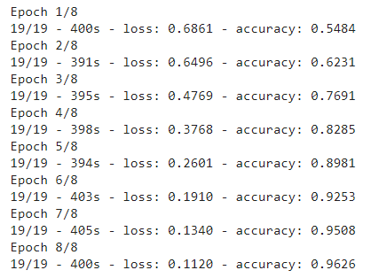
EXPERIMENTAL RESULTS
Train & Test Results
ICICI BANK LIMITED
RELIANCE INDUSTRIES LIMITED

Slide 22
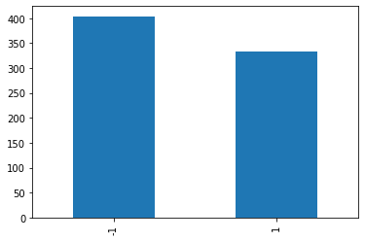
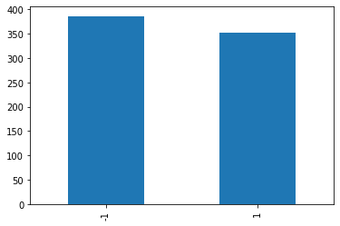
RELIANCE INDUSTRIES LIMITED
ICICI BANK LIMITED

Slide 23


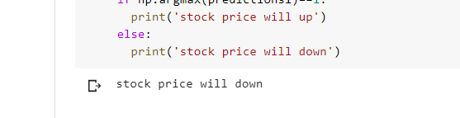
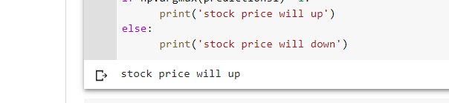
BHARTI AIRTEL LIMITED STOCK PRICE JUNE 11
RELIANCE INDUSTRIES LIMITED STOCK PRICE JUNE 11
PREDICTED SENTIMENT
PREDICTED SENTIMENT

Slide 24
CONCLUSION
Finding future trend for a stock is a crucial task
news have capacity to fluctuate stock trend.
In BSE, More number of days stock prices are falling; Even though the stock value of company doubled
Major task of this system is retrieval of reliable data that affects the market

Slide 25
If stock market experts were so expert, they would be buying stock not selling advice

Slide 26
REFERENCES
D. Yan, G. Zhou, X. Zhao, Y. Tian and F. Yang,Predicting Stock using Micro blog Moods", Journal on
China Communications, Vol. 13, No. 10, pp.244- 257, 2016.
Anurag Nagar, Michael Hahsler, Using Text and Data Min-ing Techniques to extract Stock Market Sentiment from Live News Streams, IPCSIT vol. XX (2012) IACSIT Press, Singapore
Robert P. Schumaker, Yulei Zhang, Chun-Neng Huang, Sentiment Analysis of Financial News Articles
Sentiment Analysis for Stock Price Prediction Rubi Gupta, Min Chen Computing and Software Systems, School of STEM
STOCK PRICES, LOCKDOWNS, AND ECONOMIC ACTIVITY IN THE TIME OF CORONAVIRUS Steven J. DavisDingqian LiuXuguang Simon Sheng Working Paper 28320http://www.nber.org/papers/w28320 NATIONAL BUREAU OF ECONOMIC RESEARCH
Spandan Ghose Chowdhury, Soham Routh , Satyajit Chakrabarti,
News Analytics and Sentiment Analysis to Predict Stock Price
Trends, (IJCSIT) International Journal of Computer Science
and Information Technologies, Vol. 5 (3) , 2014, 3595-3604.

Slide 27
thanks!

